Slide 1
Module 4: Software Project Management (13 hrs) – Application level
Project Management Concepts, Project Planning, Overview of metrics, Estimation for Software projects, Project Scheduling, Risk Management, Maintenance and Reengineering, Software Process Improvement (SPI): CMM Levels.

Slide 2

Project Planning
Department of Computer Science and Engineering
School of Engineering, Presidency University

Slide 3
Project Activity Planning
Project Activity Planning happens before the Scheduling phase.
Here, activities (tasks) are identified.
“Network Planning Models” are created that sequence the tasks based on logical relationship, and subsequently schedule based on the resource constraints. In this, the project’s activities and their relationships are modelled as a network, in which time flows from left to right.
Dept. of CSE, SOE, Presidency University

Slide 4
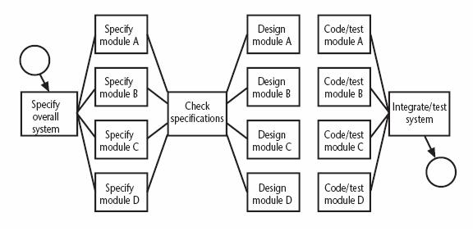
Network Planning Model: Activity-on-Arrow
Used to visualize the project as a network
  Activities are drawn as arrow joining circles, or nodes, which represent the possible start and/or completion of an activity or set of activities
Sample Fragment of a network developed as activity-on-node
Dept. of CSE, SOE, Presidency University

Slide 5
Formulating a Network Model
Constructing Precedence Network Rules-I
A project network should have only one start node
  More than one activity starting at once? Invent a ‘start’ activity with zero duration
A project network should have only one end node
  If necessary, invent an ‘end’ activity
A node has duration
Links normally have no duration
Dept. of CSE, SOE, Presidency University

Slide 6
Formulating a Network Model
Constructing Precedence Network Rules-II
Precedents are the immediate preceding activities
  All have to be completed before an activity can be started
Time moves from left to right
A network may not contain loops
A network should not contain dangles
  If necessary, connect to the final node
Dept. of CSE, SOE, Presidency University

Slide 7
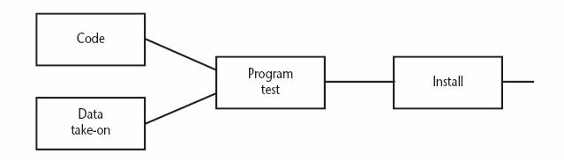
Formulating a Network Model
Fragment of Precedence Network
Installation cannot start until program testing is completed
Program test cannot start until both code and data take-on have been completed
Dept. of CSE, SOE, Presidency University

Slide 8
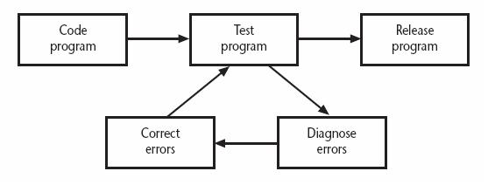
Formulating a Network Model
Network contains Loop
A loop is an error in that it represents a situation that cannot occur in practice
  Program testing cannot start until errors have been corrected?
Dept. of CSE, SOE, Presidency University

Slide 9
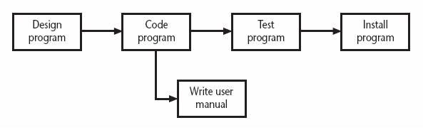
Formulating a Network Model
A Dangle
A dangling activity such as “write user manual” should not exist as it is likely to lead to errors in subsequent analysis
Dept. of CSE, SOE, Presidency University

Slide 10
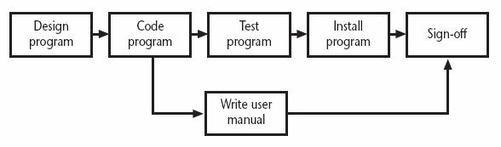
Formulating a Network Model
Resolving the Dangle
The figure implies that the project is complete once the software has been installed and the user manual written
  We should redraw the network with a final completion activity
Dept. of CSE, SOE, Presidency University

Slide 11
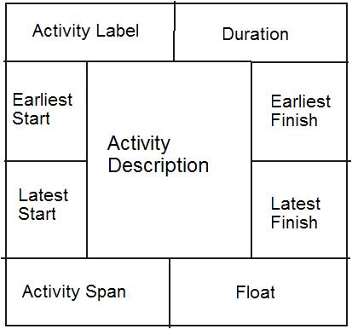
Formulating a Network Model
Labelling Convention
Dept. of CSE, SOE, Presidency University

Slide 12
Critical Path Approach
  Planning the project in such way that it is completed as quickly as possible
  Identifying delayed activities
The method requires the estimation of duration of each activity
  Forward pass: Calculate the earliest dates at which activities may commence and the project completed
  Backward pass: Calculate the latest start dates for activities and the critical path
Dept. of CSE, SOE, Presidency University

Slide 13
Estimated Activity Duration of A Project
Activity |  | Duration (weeks) | Precedents
A | Hardware selection | 6
B | Software design | 4
C | Install hardware | 3 | A
D | Code & test software | 4 | B
E | File take-on | 3 | B
F | Write user manuals | 10
G | User training | 3 | E,F
H | Install & test system | 2 | C,D
Dept. of CSE, SOE, Presidency University

Slide 14
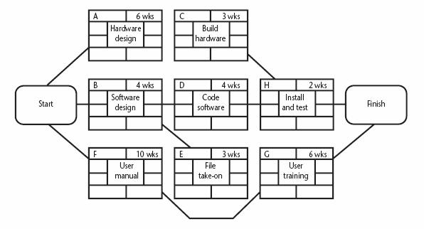
Precedence Network for the Project
3 WKS
Dept. of CSE, SOE, Presidency University

Slide 15
The Forward Pass
Calculation of Earliest Start Date - I
Activities A, B and F may start immediately
  The earliest date for their start is zero
Activity A will take 6 weeks
  The earliest it can finish is week 6
Activity F will take 10 weeks
  The earliest it can finish is week 10
Dept. of CSE, SOE, Presidency University

Slide 16
The Forward Pass
Calculation of Earliest Start Date - II
Activity C can start as soon as A has finished
  Its earliest start date is week 6
  It will take 3 weeks, so the earliest it can finish is week 9
Activities D and E can start as soon as B is complete
  The earliest they can each start is week 4
  Activity D will take 4 weeks, so the earliest it can finish is week 8
  Activity E will take 3 weeks, so the earliest it can finish is week 7
Dept. of CSE, SOE, Presidency University

Slide 17
The Forward Pass
Calculation of Earliest Start Date - III
Activity G cannot start until both E and F have been completed
  It cannot start until week 10 - the later of weeks 7 (activity E) and 10 (for activity F)
  It takes 3 weeks and finishes in week 13
Similarly, activity H cannot start until week 9 – the later of the two earliest finished dates for the preceding activities C and D
Dept. of CSE, SOE, Presidency University

Slide 18
The Forward Pass
Calculation of Earliest Start Date - IV
The project will be complete when both activities H and G have been completed
  The earliest project completion date will the later of weeks 11 and 13 – that is, week 13
Dept. of CSE, SOE, Presidency University

Slide 19
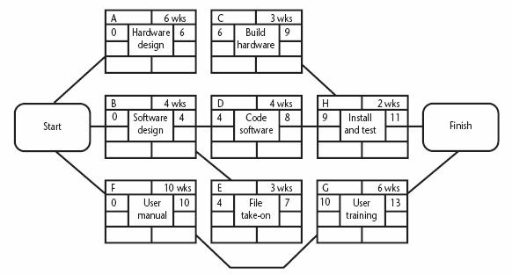
The Forward Pass
The Network after the Forward Pass
3 WKS
3 WKS
Dept. of CSE, SOE, Presidency University

Slide 20
The Backward Pass
The Latest Activity Dates Calculation-I
The latest completion date for activities G and H is assumed to be week 13
Activity H must therefore start at week 11 at the latest (13-2) and the latest start date for activity G is week 10 (13-3)
The latest completion date for activities C and D is the latest date at which activity H must start – that is week 11
  The latest start date of week 8 (11-3), and week 7 (10-3) respectively
Dept. of CSE, SOE, Presidency University

Slide 21
The Backward Pass
The Latest Activity Dates Calculation-II
Activities E and F must be completed by week 10
  The earliest start dates are weeks 7 (10-3) and 0 (10-10) respectively
Activity B must be completed by week 7 (the latest start date for both activities D and E)
  The latest start is week 3 (7-4)
Dept. of CSE, SOE, Presidency University

Slide 22
The Backward Pass
The Latest Activity Dates Calculation-III
Activity A must be completed by week 8 (the latest start date for activity C)
  Its latest start is week 2 (8-6)
The latest start date for the project start is the earliest of the latest start dates for activities A, B and F
  This week is week zero
  It tells us that if the project does not start on time it won’t finish on time
Dept. of CSE, SOE, Presidency University

Slide 23
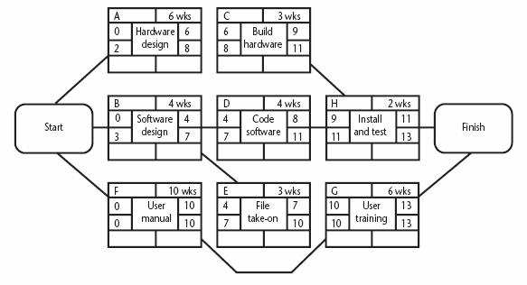
The Backward Pass
The Network after the Backward Pass
3 WKS
Dept. of CSE, SOE, Presidency University

Slide 24
Identifying the Critical Path
Critical path: One path through the network that defines the duration of the project
Any delay to any activity of this critical path will delay the completion of the project
Dept. of CSE, SOE, Presidency University

Slide 25
Identifying Float and Span
Activity’s float: the difference between an activity’s earliest start date and its latest start date (or, equally, the difference between its earliest and latest finish dates)
  A measure of how much the start date or completion of an activity may be delayed without affecting the end date of the project
Activity span: the difference between the earliest start date and the latest finish date
  Measure of maximum time allowable for the activity
Dept. of CSE, SOE, Presidency University

Slide 26
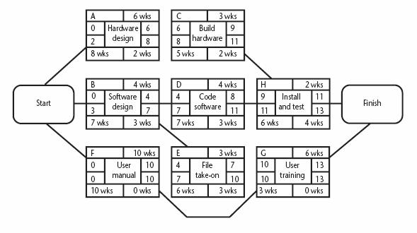
The Critical Path for the Example
3 WKS
Dept. of CSE, SOE, Presidency University

Slide 27
Significance of the Critical Path
In managing the project, we must pay particular attention to monitoring activities on the critical path
  The effects on any delay or resources unavailability are detected and corrected at the earliest opportunity
In planning project, it is the critical path that we must shorten if we are to reduce the overall duration of the project
Dept. of CSE, SOE, Presidency University

Slide 28
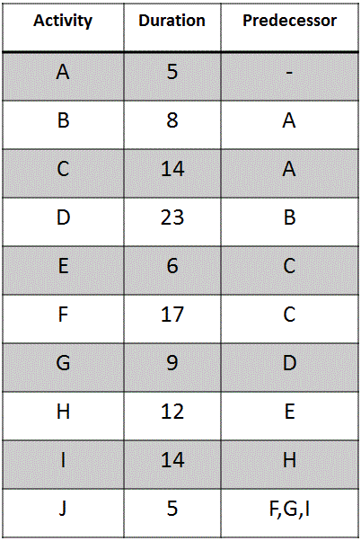
Dept. of CSE, SOE, Presidency University

Slide 29
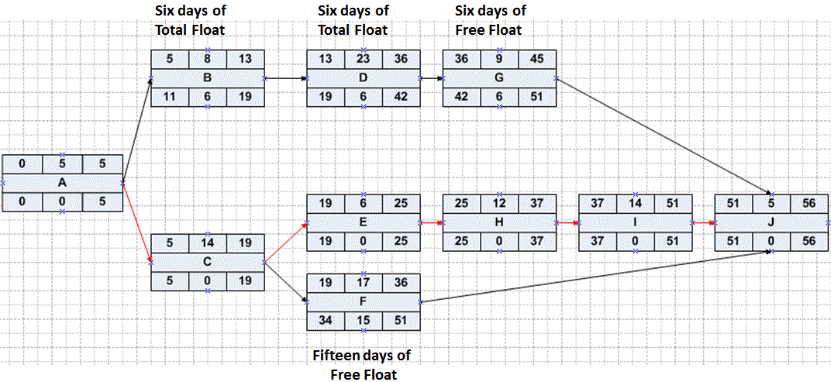
Dept. of CSE, SOE, Presidency University

